Slide 1
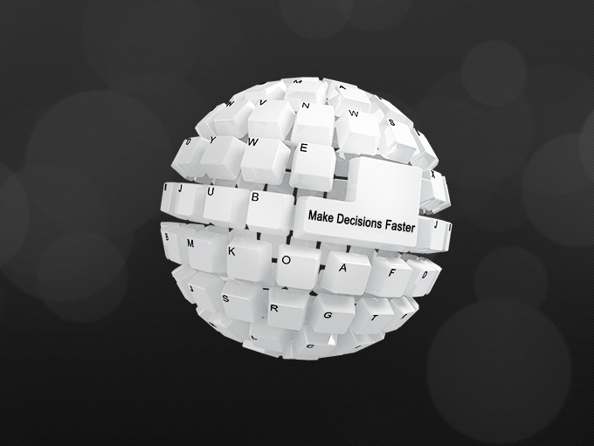
Analytics, BI & Data Integration

Slide 2
Data Explosion
We have 2.5 quintillion bytes of data generated everyday!
Over the last two years alone 90% of the data in the world was generated
Major contributors of the Data are:
Internet
Social Media
Communication
IoT
Services
Digital Photos

Slide 3
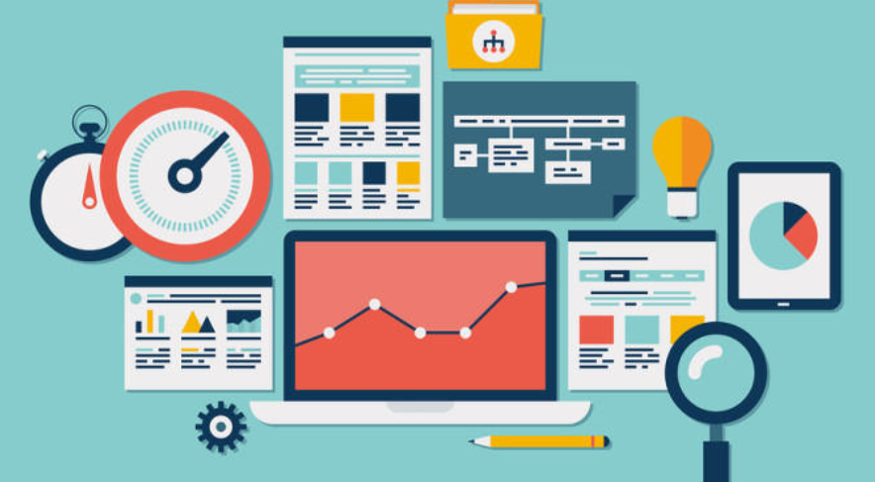
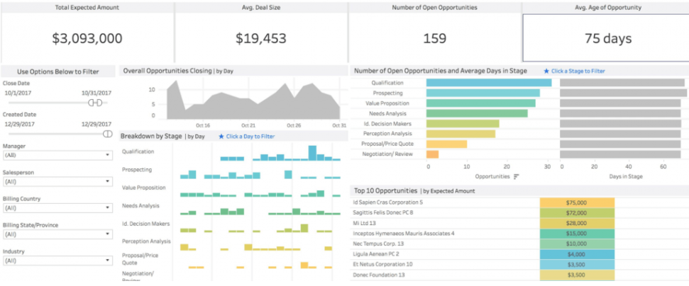
Analytics Overview
Description, Comparison, Grouping, Classification & Prediction
Proactivity & Anticipating Needs, Mitigating Risk & Fraud, Delivering Relevant Products, Personalization & Service, Optimizing & Improving the Customer Experience
What happened? How or why did it happen? What’s happening now? What is likely to happen next?
Boost Customer Acquisition and Retention, Solve Advertisers Problem and Offer Marketing Insights, Risk Management, Driver of Innovations and Product Development
Interactive Dashboards, Self-serve Interactive Reporting, Enterprise Reporting, Proactive Detection and Alerts, Actionable Intelligence, Spatial Intelligence via Map-based Visualizations

Slide 4
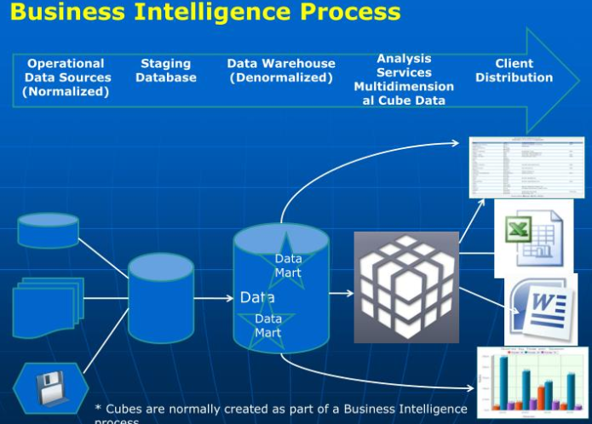
Why use Business Intelligence ?
Business intelligence (BI) is a technology-driven process for analyzing data and presenting actionable information to help executives, managers and other corporate end users make informed business decisions.
Common functions of BI include reporting, online analytical processing, analytics, data mining, process mining, complex event processing, business performance management, benchmarking, text mining, predictive analytics and prescriptive analytics.
Improves Decision Making Process
Information can be accessed and shared easily
Helps analyze Gaps and Leaks in system
Helps understand Your Business

Slide 5
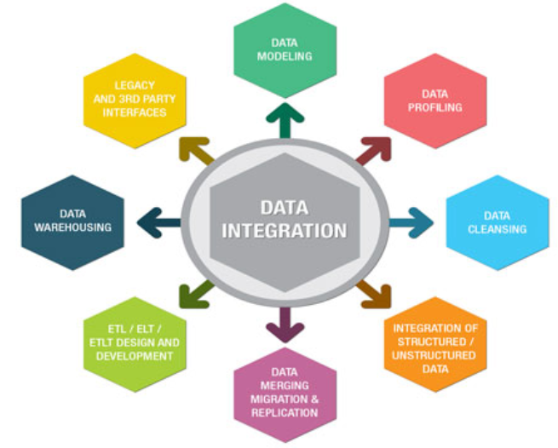
What is Data Integration
Data integration is the combination of technical and business processes used to combine data from disparate sources into meaningful and valuable information
Improves collaboration and unification of systems
Problems - Data Silos, Slow Analysis, Deep Dives
Benefits - Reduce data complexity, more unified systems, Make data more available, Easy data collaboration, smarter business decisions, Data integrity
Enables high-volume Data, high-performance batch loads & Real Time Data to be loaded in Hours!

Slide 6
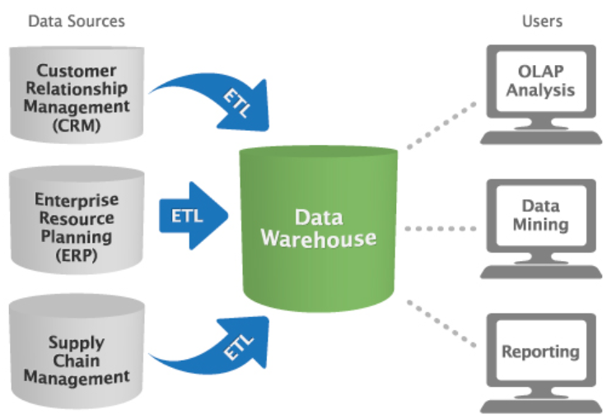
Data Warehousing Fundamentals
Data warehousing is a technology that aggregates structured data from one or more sources so that it can be compared and analyzed for greater business intelligence.
Data warehouses are typically used to correlate broad business data to provide greater executive insight into corporate performance.
Data warehouses use a different design from standard operational databases. Data warehouses are designed to give a long-range view of data over time.
Data warehouses trade off transaction volume and instead specialize in data aggregation
OLAP data with Star Schemas, Snowflake Schemas with Fact & Dimension Tables, Cubes etc.

Slide 7
ETL & ELT process
ETL is short for Extract, Transform, Load, three database functions that are combined into one tool to pull data out of one system and place it into another system.
Extract is the process of reading data from a database. In this stage, the data is collected, often from multiple and different types of sources.
Transform is the process of converting the extracted data from its previous form into the form it needs to be in so that it can be placed into another database. Transformation occurs by using rules or lookup tables or by combining the data with other data.
Load is the process of writing the data into the target database.
ETL vs E-LT

Slide 8
 | OLTP | OLAP
Source of Data | Operational data: OLTPs are the original source of the data. | Consolidation data; OLAP data comes from the various OLTP Databases
Purpose of data | To control and run fundamental business tasks | To help with planning, problem solving, and decision support
What does Data Reveal | Snapshot of ongoing business processes | Multi-dimensional views of various kinds of business activities
Queries | Relatively standardized and simple queries Returning relatively few records | Often complex queries involving aggregations
Speed | Typically very fast | Relatively Slow
Space Required to store | Relatively Small | Larger due to presence of History Data
Database Design | Highly Normalized – 3NF | De-Normalized
Volume of Tables | Very High | Relatively Low

Slide 9
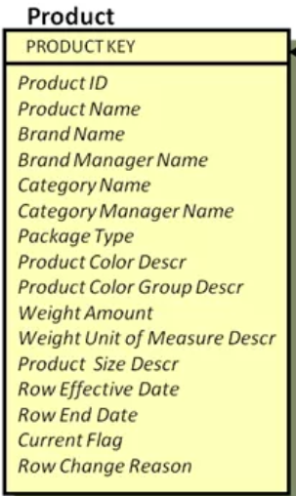
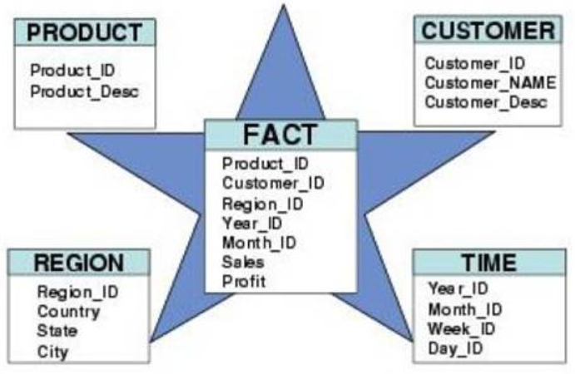
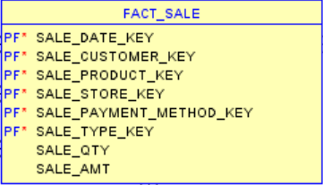
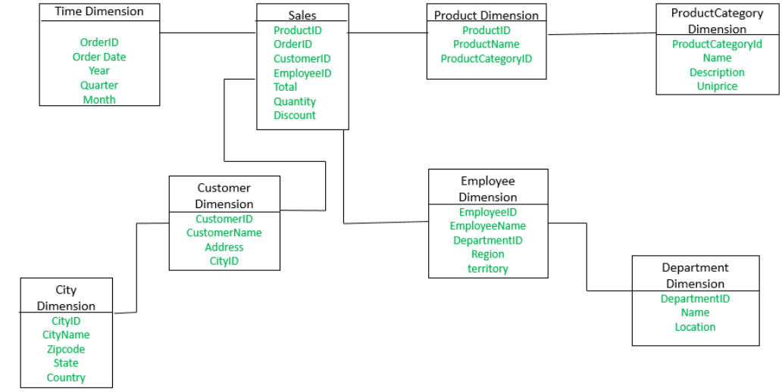
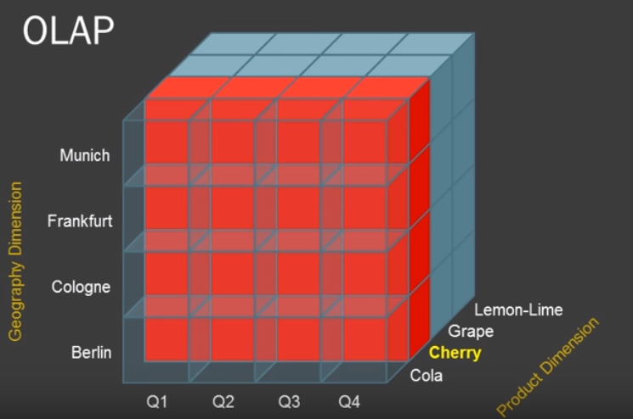
Commonly used Data Structures
Fact Table
Dimension Table
Star schema
OLAP Cube
Snowflake schema

Slide 10
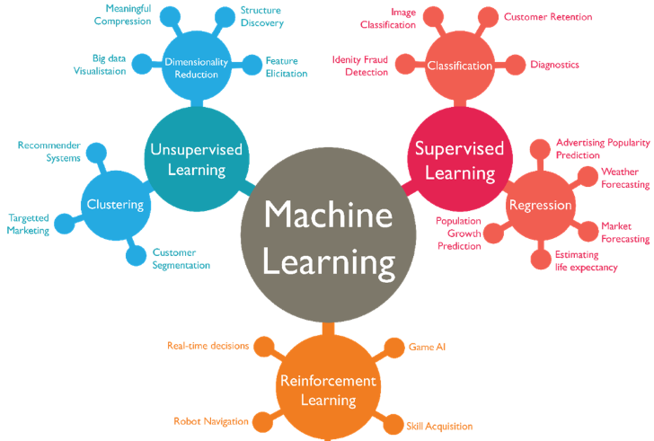
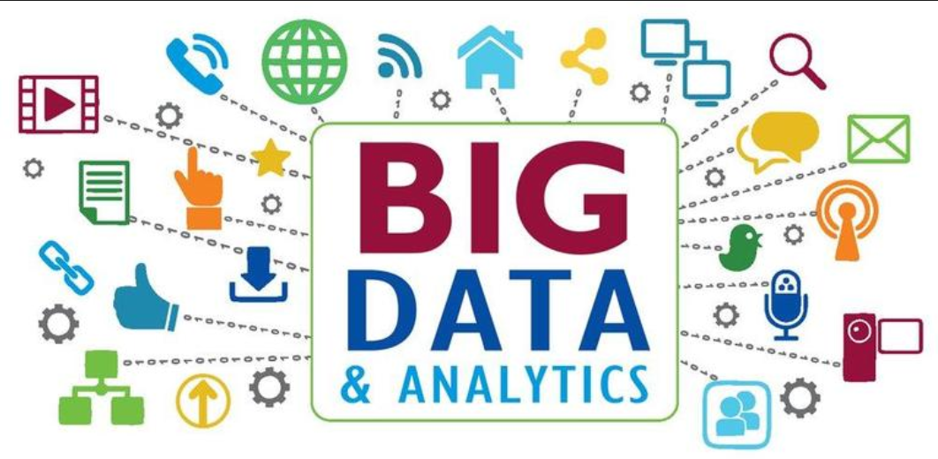
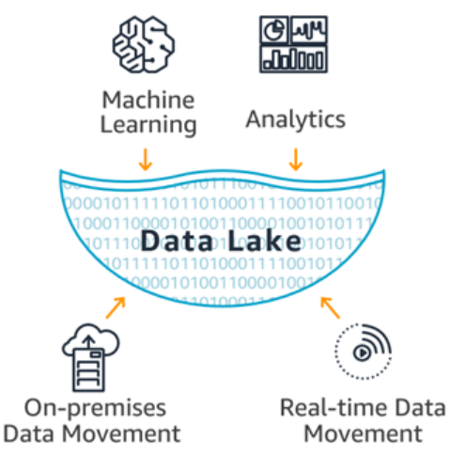
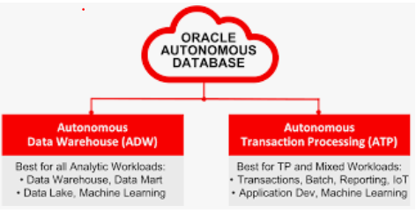
Upcoming Technologies

Slide 11
DiLytics Contact Information
Nachiket Parab (Nash)
Director, DiLytics Canada Inc.
+1 (902)223-4792
nparab@dilytics.com

