Slide 1
CIO Perspectives on Leadership and Change
In association with
Martin Davis ^{MBA, BSc, PMP} CIO, Senior Executive Adviser
Notes:
Who am I?
CIO & Executive Leader
JDI, Ford
Studied and blogged on Change Management and Leadership for >15 years
Hands-up:
How many of you are responsible for a team (small or large)?
How many of you are leaders? I have news for you – you all are!
“Leadership is a choice not a position” — Stephen Covey
We will take 45 minutes exploring Leadership and Change, plus 15 minutes for Q&A – have your questions ready!
But feel free to ask questions as we go through – its often easier
Lets get started:
How may companies fail due to Leadership issues?

Slide 2
IN THE LAST 15 YEARS, 52% OF THE FORTUNE 500
COMPANIES HAVE BECOME EXTINCT
Notes:
Many failed due to leadership issues
Failing to innovate, failure to drive forward, complacency
<Click>
Why does this matter to you?
Because you are all leaders – you need to drive within your company
SO, What is Leadership?

Slide 3
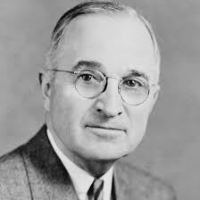
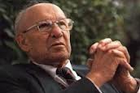
What is Leadership?
“Progress occurs when courageous, skillful leaders seize the opportunity to change things for the better” Harry S Truman (1884 – 1972)
“Management is doing things right; leadership is doing the right things” Peter Drucker (1909 – 2005)
Notes:
Progress occurs when courageous, skillful leaders seize the opportunity to change things for the better
Changing things for the better, seizing the opportunity
Management is doing things right; leadership is doing the right things
Management about controlling the process
Leading is about deciding what to do
We have discussed what leadership is
Lets now talk more about the components of leadership
What makes up leadership?

Slide 4
Notes:
Ok – time to get you thinking – what is leadership?
<click when done to reveal>
This slide highlights the key attributes
Heather Moyse, double Olympic gold medalist
What is leadership?
• Inspiring others
• Leadership by example
• Focus on the outcomes
• Focus on what you can control
• Break down the task into manageable and achievable pieces
• Believe in the possibilities
• When faced with a Challenge:
◦ - See it as an opportunity
◦ - Instead of as an obstacle
Let’s explore some of those components – starting with Vision

Slide 5
Having a Vision!
“Good business leaders create a vision, articulate the vision, passionately own the vision, and relentlessly drive it to completion.”
Jack Welch
Chairman & CEO, GE, 1981-2001
Notes:
Jack Welch, Chairman & CEO of GE for 20 years (1981 to 2001).
During that time, the company's value rose 4000%
What is your vision? Own that vision
Share it with others, Get them to support you
Drive it to completion
It might be a personal vision
One for your team, your group
Or your hockey team!
Own it and drive it!
My vision…
- Delight the customer and provide competitive advantage thru technology
How many of you have a Vision?
Hands-up
Ask a couple of people to speak

Slide 6
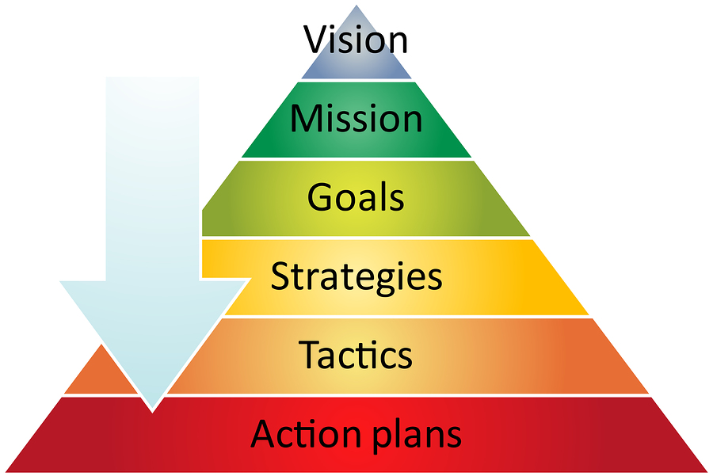
Vision & Strategy
Setting the Direction and Driving towards it
What is your vision for the Organisation?
Notes:
Achieving your vision
Break it down into goals and strategies
Tactics and action plans
“How do you eat an elephant?” “One bite at a time”
Critical you know where you want to take the organisation and how you will get there – key to leadership success
If you are going to take one thing away from today then its on the next slide
What is the untold key to leadership?

Slide 7
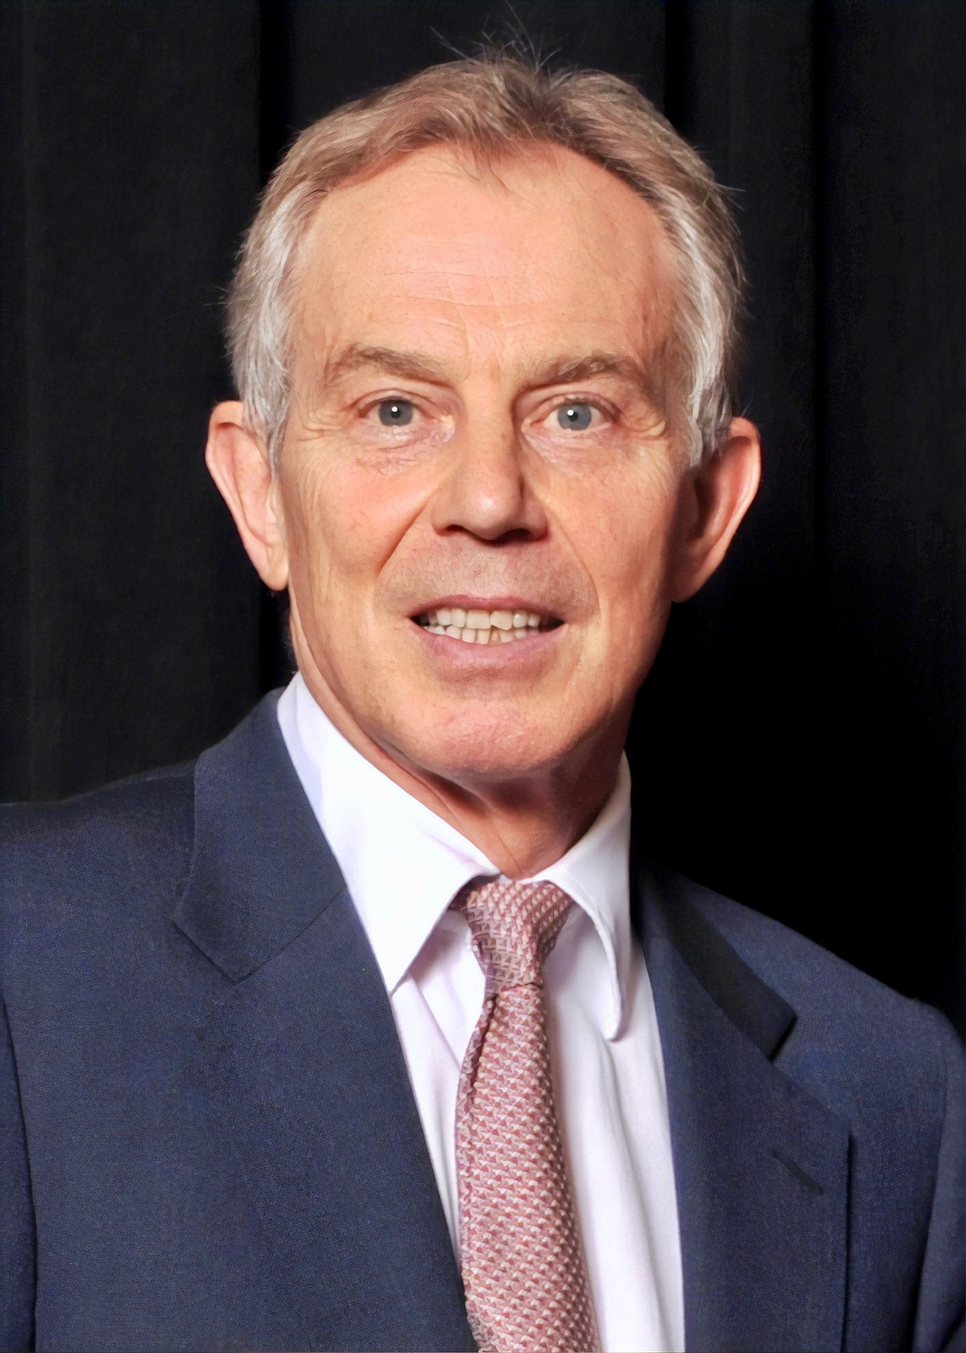
Be Brave, say NO!
Consulting / Decision Making
The art of leadership is saying no, not saying yes. It is very easy to say yes.
Tony Blair
Tony Blair
Former British Prime Minister
Notes:
When was the last time you said ‘No’ to someone requesting a piece of work?
Very easy to say ‘Yes’, Saying ‘No’ requires more work and justification
Are you trying to please people by saying ‘Yes’ ?
Do you really have the time to do this extra piece of work?
What would you have to stop doing in order to fit this new work in?
Be brave and say ‘No’ – be prepared to defend your decision
Or negotiate removing some other piece of work from you
Connected to this is how you influence people.

Slide 8
Up, Down & Sideways
Relationships & Influencing
Leadership is the art of getting someone else to do something you want done because they want to do it.
Dwight D. Eisenhower
Notes:
Building Relationships
Influencing others
I spend most of my time doing this
The core of Leadership
You cannot control people only influence them
with the leadership team, VPs
with the owner of your business
With people that do not report to you
you need to get good at doing this
The core…. W I I F M !!!
Understand their motivations and put things in those terms
Try volunteering to the board of a non-profit or your kids sports team – great way to practice this!
Along with influencing we get into delegation.

Slide 9
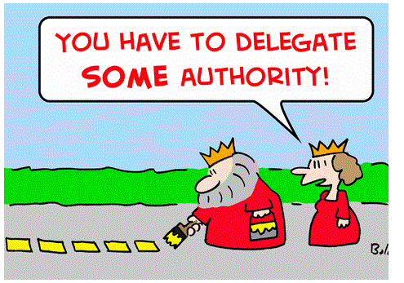
Letting Go
Delegating
Notes:
Becoming a leader you learn a couple of things:
You cannot do everything
You do not know everything
These are common mistakes new leaders make
Key to the transition from managing to leading
Delegating is critical, but you must do it right
Be clear on what is required
Provide help and support when needed
<Use example of the IT Leader who tried to do it all themselves>
DO NOT do it for them – demotivates….
Delegating is a Motivator – gives your team responsibility
So what makes a high performing team?

Slide 10
Coaching and Developing People
A key role of every leader
Notes:
Your role as a leader is to encourage, coach and get the best from your people
If you fail to do this properly your people will leave
The pit crew in F1 is a great example
Common purpose, motivated, trained, synchronised
DRIVE Project example
Common purpose, one team
What defines you as a leader?

Slide 11
Leadership Challenges
Notes:
As a leader we are challenged every day – how we react to these challenges defines us.
Frequently these challenges are the result of changing business conditions.
Why do companies need to change?

Slide 12
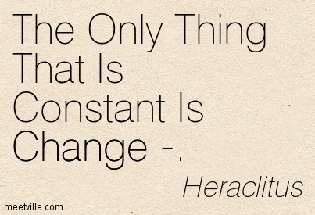
Why do Companies need to Change?
Notes:
The only constant is change – Heraclitus (Greek Philosopher)
The World is changing minute by minute
The age of Information
The age of the customer
The connected age
All of these are changing how business takes place
The speed of business and change are increasing exponentially
Think about what you can do on your phone now vs 10 years ago
What do you demand as a customer? E.g. Information, instant access, service, status
How does that translate to your daily job?

Slide 13
Why do Companies need to Change?
Notes:
business stands still = going backwards
A company must constantly look for how it can be better,
or look for the disrupters that might harm it
Or look for the next big opportunity
Examples of those that failed to do so are easy to find: Blackberry, Kodak etc
Blockbuster example
CEO had a digital vision, the board did not get it – they fired him
Netflix offered themselves to Blockbuster for $50m and were turned down
Industries that have had to evolve or die: Music Industry, Newspapers etc

Slide 14
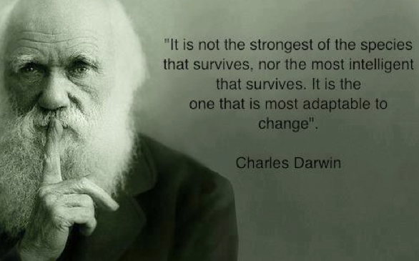
Why do Companies need to Change?
Notes:
<read quote>
“Most adaptable to change”
Think of this in terms of a companies culture and in terms of the leadership’s impact
If you can adapt you can survive
Think of the animals that have adapted over the centuries and are still around vs those that are extinct
Think of the companies that have failed to evolve sufficiently
We talked about Blockbuster as one example
What about Sears
They had a great model with the catalogue business plus the stores
It was an ideal platform to evolve to digital
They failed
Others like Best-Buy have been very successful in adapting and are getting stronger
So ask yourself this question:
How will I lead in my company?

Slide 15
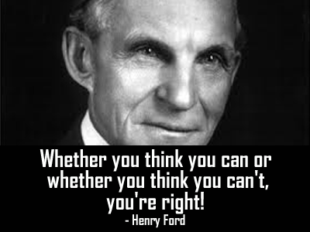
Wise words to end with!
Own & drive your Vision
Be ready and adaptable to change
Search for opportunities
Delegate and motivate your team
Use Influence to get things done
Have the Strength to say NO
Notes:
Be the best Leader you can possibly be
Your success is down to you!!
Can you achieve your goals?

Slide 16
THANK YOU!
MBA, BSc, PMP
Martin Davis
CIO & Senior Executive Adviser
Blog: https://martindavis01.wordpress.com/
Twitter: @mcdavis10
In association with
Karen Fegarty
Regional Vice President Sales
902-499-4983
Karen.fegarty@marinerinnovations.com

Slide 17
Please take a moment and complete our
Speaker Survey at:
www.pdsummit.ca
Hope you enjoyed the presentation!
Feedback is a gift and its the only way we can make PDS 2020 even better!

