Slide 1
Unicorns are Real
Recruiting and Retaining Newcomer Talent in Atlantic Canada

Slide 2
Hello!
I am Karla Pooley
AKA the Manager of Org Development at Blue Spurs Consulting in Fredericton, NB
You can find me at karla@bluespurs.com

Slide 3
About this presentation
Implementing and meeting diversity quotas
Pro affirmative action
Navigating the immigration process
Recruiting, engaging, hiring, onboarding and retaining a talented and diverse workforce

Slide 4
Recruitment realities
War on (senior) talent
Competition is global
Companies don’t hire to be nice
It’s not personal, it’s business

Slide 5
Brain drain
Amazing things here
Need talent to grow
Perception that you can’t have a good IT career
Growth in security, data analytics, cloud and IoT sectors
Schools, established professionals, newcomers

Slide 6
What are your options?
New grads
Too junior
Inexperienced
(Re)training
Takes too long
Expensive
Poaching
Robbing Peter to pay Paul

Slide 7
Gov’t is creating incentives to solve hiring issues
Express Entry with Provincial Nomination
4,500 skilled newcomers arriving yearly
Atlantic Immigration Pilot Program

Slide 8
Immigration programs
Express Entry with Prov Nomination
Educated + experienced
Nominated by province
PR processed in 6 -8 months
Arrive and start seeking housing + employment
Limited support
Atlantic Immigration Pilot Program
Hired by company (no LMIA required)
Must meet prevailing wage
PR processed in ~ 6 months
Company works with settlement agency to create settlement plan
Lots of support
Notes:
My story @ McCain
11 years in recruiting
Florenceville is not a location of choice
Started with 2 Cuban families (recruiting and settlement)
May did not stay for duration of contract
New director implemented diversity quotas
Hard enough to find one person, now have to find someone with the proper background?
Fredericton has different challenges
Still not a location of choice
Very competitive

Slide 9
“I don’t think they’ll fit in”
“Why bother? They’ll go to Toronto anyway”
“I can’t understand their accents”
“I already have one Indian on my team”
“It’s too hard - I don’t even know what to do”

Slide 10
How hard is it to recruit someone who is already here, and who wants to be here?
Our companies serve global clients, and we need a global workforce

Slide 11
About Blue Spurs
Cloud and IoT professional services company
Offices in Fredericton, Saint John, Moncton, Charlottetown and Halifax
Developers, QA, PMs, DevOps and Solution Architects
Agile/Scrum
80ish employees
73% male, 27% female
26% staff born outside Canada
2nd language: Ukrainian/Russian
3rd language: Hebrew

Slide 12
Where We’re From
Russia
Ireland
Ukraine
Our office
Armenia
Israel
Egypt
Bangladesh
India
Vietnam
Nigeria
South Africa

Slide 13
Some of my colleagues
Senior FS developer (Armenia)
Senior
Auto QA
(Israel)
Senior Python Developer
(Ukraine)
Android Developer
(South Africa)
DevOps
(India)
TPM
(Ukraine)
Salesforce Architect
(Egypt)
Cloud Solutions Architect
(Nigeria)
Notes:
These are not junior-level people
Incredibly skilled, helped us take on new business we ordinarily wouldn’t be able to do
Helped us grow the business

Slide 14
What we look for
Specific and relevant technical skills
Hands-on experience (“have done”)
Good English communication skills
Previous work with overseas North American companies
AWS certifications/cloud experience
Agile/Scrum

Slide 15
What we don’t look for
Jacks of all trades / willing to fill multiple roles
Huge multinational consulting backgrounds
Junior talent / limited work experience
Outdated skills/need retraining
Limited English
New grads (unless they were our co-op student)

Slide 16
Why they stay
Treat like locals
Pay fair wages
Recognize previous experience
Assign meaningful work
Give opportunities to lead
Notes:
Turnover is rare - 5 people in 3 years, out of 22
Same reasons as everyone else

Slide 17
Diversity hiring is not
Affirmative action
Tokenism
Meeting quotas
Hiring un/under-qualified people

Slide 18
Diversity hiring is
Recognizing the best sources of talent
Understanding how to reach them
Connecting with them
Hiring the best people for the job
You maximize your success when you expand your borders

Slide 19
Our process is simple
1
2
3
4
5
Recruit
Hire
Engage
Onboard
Retain
Notes:
This isn’t a roadmap that will guarantee success
It’s another tool you and your team can use

Slide 20
Recruit
1
Building your pipelines

Slide 21
Recruiting your candidates
Posting ads
Encourage applicants who are or will be newcomers
Focus on what they will do in the role (specific)
Questionnaire
1) Where are you located?
2) Are you part of any immigration programs? Do you require sponsorship?
3) What is your arrival date?
LinkedIn + Indeed
Newcomers often update their profiles/resumes with CAN location when they begin immigration process
Referral program
Good people know good people
$3,500 bonus, paid after probationary period
Community partnerships
Chamber of Commerce
IT Incubation Centres
Multicultural Associations
Connector programs
ONB Connector
ISANS
Halifax Partnership

Slide 22
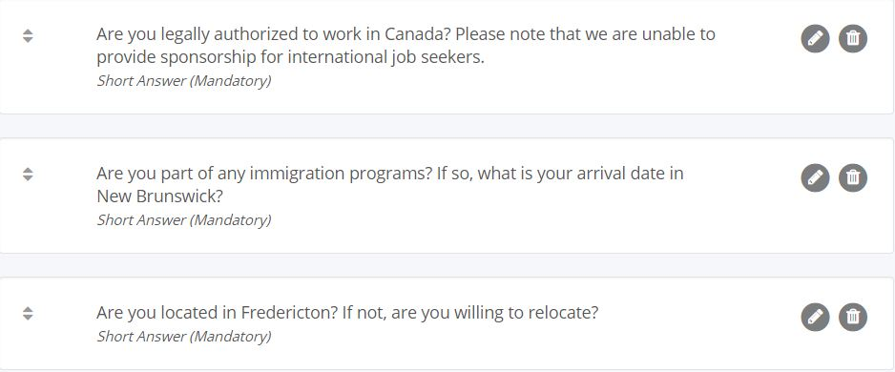

Slide 23
Engage
2
Getting them interested

Slide 24
Engaging your candidates
Interviewing
Screen, tech test, tech interview
Assess skills, fit, communication and expectations
Use visual tools
Interview over Skype/Hangouts to highlight office and location
Get help
Ask a colleague from home to participate, and speak with them in own language
Interview template
Keep questions simple
Don’t use slang or lingo
Give lots of information
Talk about the culture, team sizes, projects, social events, awards, etc.
Keep in touch
Candidates will often refer other newcomers

Slide 25
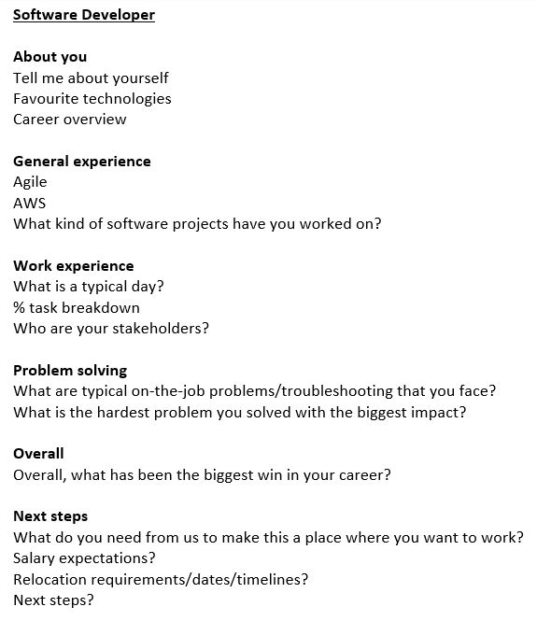
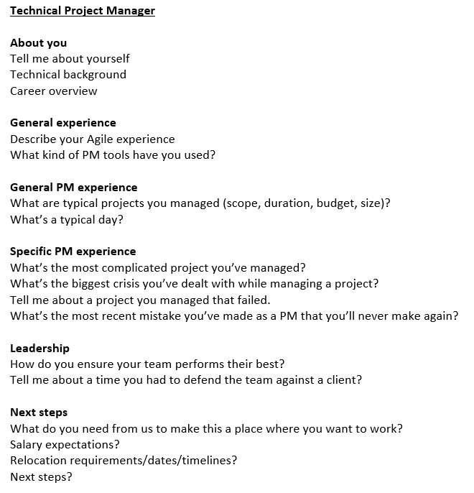

Slide 26
Assess and Hire
3
Getting them in the door

Slide 27
Assessing & hiring your candidates
Technical test
Use technical tests
“How” is as important as “what”
Relocation allowance
$5,000 for relo expenses
Paid back in full if they leave before 2 years
Frequent check-ins
Keep in touch via email
Share company news, events and updates
Clear expectations
Give a schedule so they know what to expect (day 1, week 1, first 90 days)
Systems and accounts
Ensure all their systems and accounts are set up for their first day
Company swag
Give a welcome gift with your logo

Slide 28
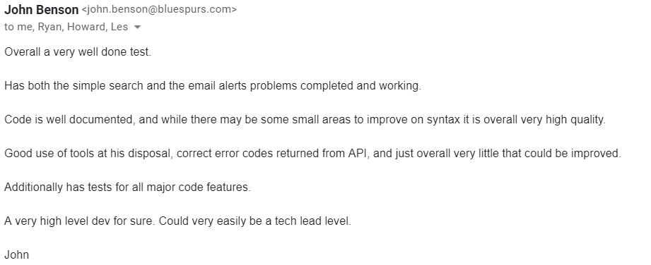
Typical feedback after the Dev exercise

Slide 29
Onboard
4
Getting them connected

Slide 30
Onboarding your employees
Day 1
Standard onboarding
Lunch with the team
Meet with OD and executives to build relationships
Communication + norms
Discuss office, company and team culture
Mentorship
Match with a person on their team
Intranet
Company Intranet with access to onboarding and process documents, news, pictures, etc.
Intranet Profile
Making a personal profile in the employee directory
Profile is mandatory, all questions are not
Company newsletter
Introducing new employee in company newsletter
Help crowdsource for them (e.g. best place for a beer, favourite walking trail, etc.)

Slide 31
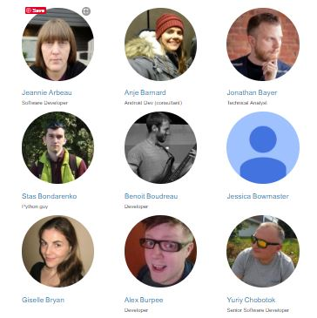
Employee Directory

Slide 32
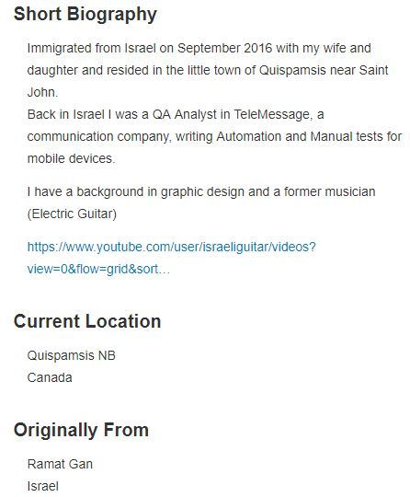
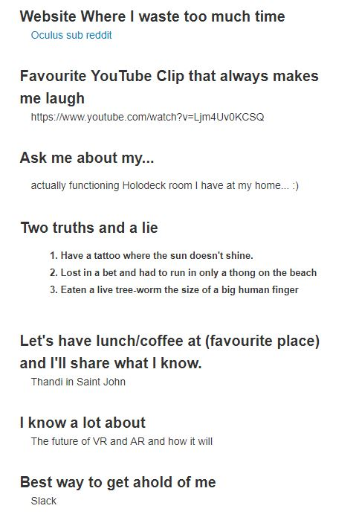

Slide 33
Retain
5
Maintaining the connection

Slide 34
Retaining your employees
Building relationships
Reaching out to them frequently
Offering advice/suggestions
Monthly one-on-ones
Honouring experience
Hiring at proper level
Assigning work that aligns with their experience
Recognizing their contributions
Slack
Team and interest-specific chat channels to build relationships
Over communicating
Send reminders about holidays, local events, etc.
Reminders
“Don’t burn yourself out”
“Take sick time”
“Take vacation time”
“Go home!”
Reassurance
“You’re here for a reason”
“It’s ok to make mistakes”
“You are a valuable employee”

Slide 35
Extras
6
What we’ve done

Slide 36
Extras for your employees
Company activities
Int’l potlucks
Hackathons
Skating/winter sports
Friday socials
Off-hours activities
Plan family-friendly outings and events for the evening/weekend
Leadership circle
Share and debate leadership videos and concepts
Canadian help
Intro to Canadian income taxes
Assistance with RRSPs, RESPs, etc.
No cultural ghetto
Ensuring people are spread out evenly on projects so they build relationships with other employees
Working abroad
Working abroad temporarily while visiting friends/family

Slide 37
Results
No magic formula
Shouldn’t be doing anything different
You don’t need to change your strategy
These are things you should be doing for all candidates and new hires, not just newcomers

Slide 38
Challenges
Hard work to find a job
Hard work to find the right person for the job
Hard work to integrate into a new job / new environment
Issues
Spousal
Isolation
Loss of cultural network
Are you hiring a body to fill a seat, or a partner?

Slide 39
Notes:
3 years at BSC
Hired as Head of Talent to quickly scale up the business
Never made it a goal to increase diversity
Hired the best people for the job, who happened to be newcomers
We are richer, more successful and a better place to work
Recognised as one of the top 100 SME in Canada by the G&M
In part due to diversity and the programs we have in place to support ALL staff

Slide 40
Why am I sharing?
We’re all in this together
We’re all playing in the same sandbox
We’re all trying to grow
We all need talent
We need to become better
If we get better, it becomes easier for all of us
Notes:
Toronto, Montreal and Vancouver have built-in newcomer communities

