Slide 1
The Nova Scotia Cloud
Building, Operating, and Marketing
Cloud Services in Nova Scotia

Slide 2
IAI Cloud Services – A Case Study
- Company background
- IAI’s decision to provide cloud services
- The marketplace for cloud services
- Lessons learned

Slide 3
IAI Background
A telecom service provider since 2002
Based in Halifax, serving the Maritimes
Began with a focus on telecom services to large-scale customers on our own fibre-optic network
Grown in size, expertise, and services

Slide 4
Designed for Business
Today we provide a comprehensive suite of ICT services to our customers:
Direct Fibre
Data Centre
Telephone
Internet
Virtual and Host Services
Professional Services

Slide 5
Launching Cloud Services
In 2011, we launched cloud-based services
Now operating our 2nd generation of cloud infrastructure services
Our team has learned a lot about the market, the technology, and our customers

Slide 6
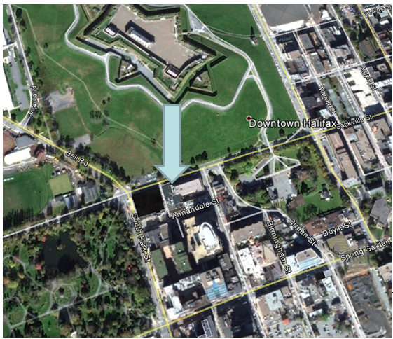
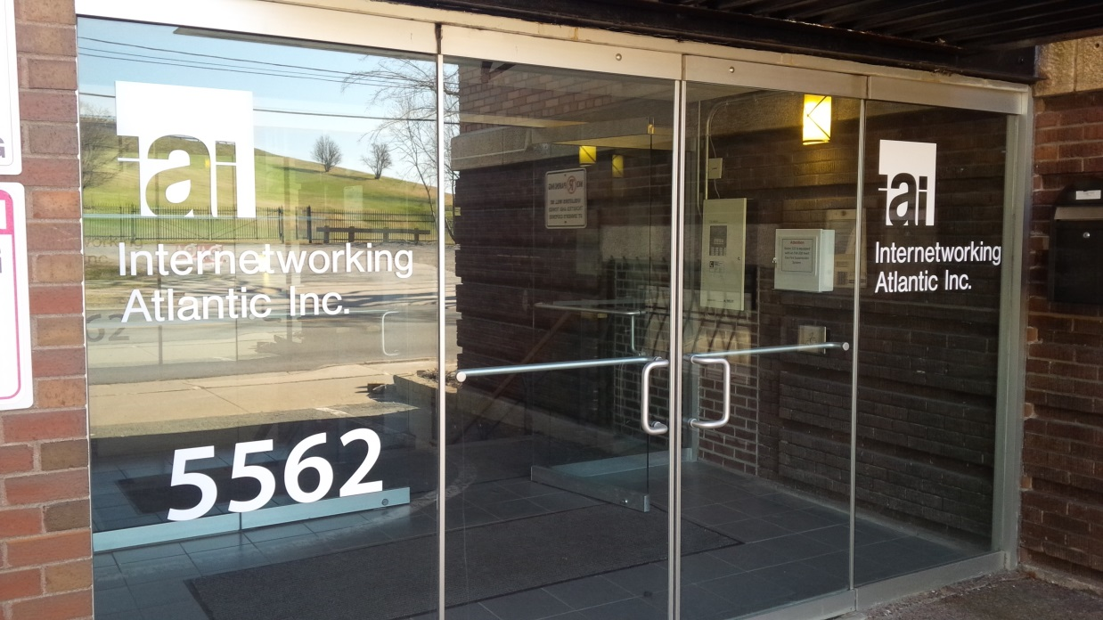

Slide 7
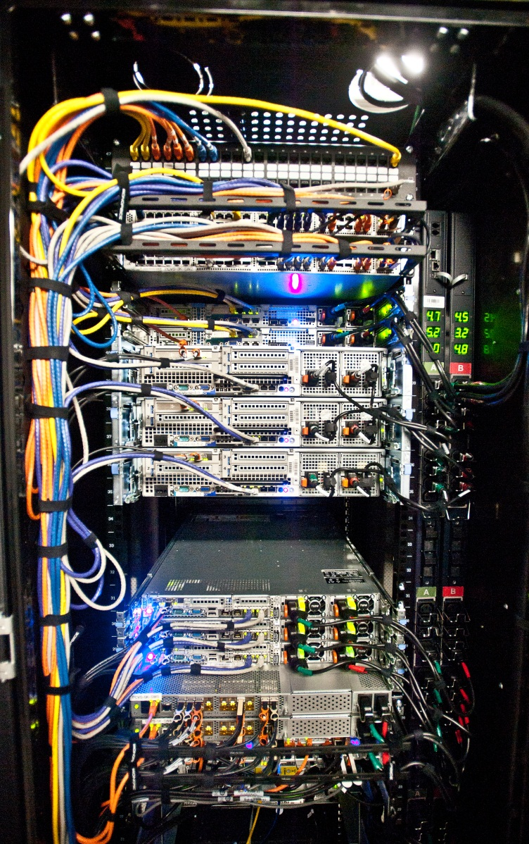

Slide 8
“Cloud” means many things
The Cloud creates both momentum and confusion in the marketplace
Everyone wants to associate their products and services with “The Cloud”, and adapt the meaning to their own use.

Slide 9
Defining the Cloud
Broad Categories:
Software as a Service (SaaS)
Platform as a Service (PaaS)
Infrastructure as a Service (IaaS)

Slide 10
Infrastructure as a Service (IaaS)
- On-demand access to virtual resources.
Usually refers to virtual servers and storage services
- Customers make use of Service Provider’s infrastructure
- Flexible resource allocation: use only what you need

Slide 11
IAI’s Cloud Services
- We offer a locally hosted IaaS service called PCVS
- PCVS is a high-performance Vmware / Dell / Cisco / EMC based IaaS platform
- PCVS is hosted in our State-of-the-Art Halifax Data Centre

Slide 12
Why adopt IaaS?
- Reduced need for capital outlay
- Fewer headaches associated with the operation of extensive infrastructure
- Flexibility to increase or decrease resources on demand

Slide 13
Segmenting the IaaS Market
- Our experience is that customers in different market segments are adopting IaaS for different reasons
- Here is an analysis of our experience

Slide 14
What are the IaaS market drivers:
- Existing Equipment End of Life
- Refocusing IT staff on core business
- Productivity gains and cost reductions
- CAPEX / OPEX decisions

Slide 15
IaaS adoption by Segment and Sector
- Non IT SMEs
- IT Firms, Internet-based businesses, software developers, media firms
- Larger businesses
- Institutions and governments

Slide 16
Non IT SMEs
- Primary driver is the bottom line. Moving to the cloud must improve productivity or reduce costs immediately.
- Yet faced with growing IT needs, small number of IT staff, EoL issues, requirements made by vendors and customers
- Worried about security and privacy but little expertise.

Slide 17
Non IT SMEs
The bottom line: Interested, but not knowledgeable. Need to keep costs low, but facing challenges.

Slide 18
IT Firms, Internet-based businesses, software developers, media firms
- Confident and knowledgeable regarding the Internet
- Aware of benefits, and better performance for Internet based customers
- Able to navigate security and privacy issues
- Usually price sensitive and knowledgeable of market.

Slide 19
IT Firms, Internet-based businesses, software developers, media firms
The bottom line: Early adopters (no surprise…) and savvy buyers. High value placed on flexibility and performance.

Slide 20
Larger enterprises
- Significant sunk costs in IT infrastructure. May have existing data centre(s).
- Existing IT departments with skilled staff but may have vested interests in status quo.
- Departmental users often see IaaS as a way to get what they want.
- Concerned but knowledgeable about security and privacy. Good understanding of risk management.

Slide 21
Larger enterprises continued…
- Interested in pilot programs and trials.
- Have well established practices for evaluating OPEX vs CAPEX decisions.
- Concerned about control, and escalating costs.

Slide 22
Larger enterprises
The bottom line: Rational adopters but facing hurdles with existing infrastructure. Departmental users may push IT staff toward IaaS.

Slide 23
Institutions and governments
- Security and privacy are primary concerns due to public scrutiny. Risk averse in this area.
- Would like to be seen as leaders in embracing new technologies.
- Extensive existing assets, but under pressure to increase productivity.
- May have statutory requirements regarding domicile of data. (PIIDPA for example)

Slide 24
Institutions and governments
The bottom line: Want to be seen as leaders, but cannot afford a privacy or security issue. Pressured to reduce costs.
OPEX vs CAPEX decisions budget driven.

Slide 25
Our marketing strategy
- Go head-to-head with Amazon and Google
- Create a differentiated service aimed at regional customers.
- Leverage our existing fibre-optic network and data centre.
- Target customers not comfortable with data in some ephemeral cloud somewhere. Where’s my data?

Slide 26
Our differentiators
- Locally hosted in Halifax
- Highly secure, can be configured to be entirely private, with private fibre-optic links.
- Hybrid possibilities – we can host IaaS customers’ legacy non-virtualized computers in our data centre
- High-capacity multi-homed Internet connectivity as required
- Personal customer service.

Slide 27
Lessons Learned
- Service clarity is paramount. Customer experience is based on expectations. With a new service paradigm such as The Cloud, it is very important that customers understand the service provided.
- Many customers require external expertise to make a successful transition to cloud-based services.

Slide 28
Lessons Learned continued…
- Customers in different market segments have widely differing drivers. This needs to be well understood.
- The Cloud requires new thinking about security and reliability – customers and suppliers need to be fluent and comfortable with these topics. SOC2 as an example…

Slide 29
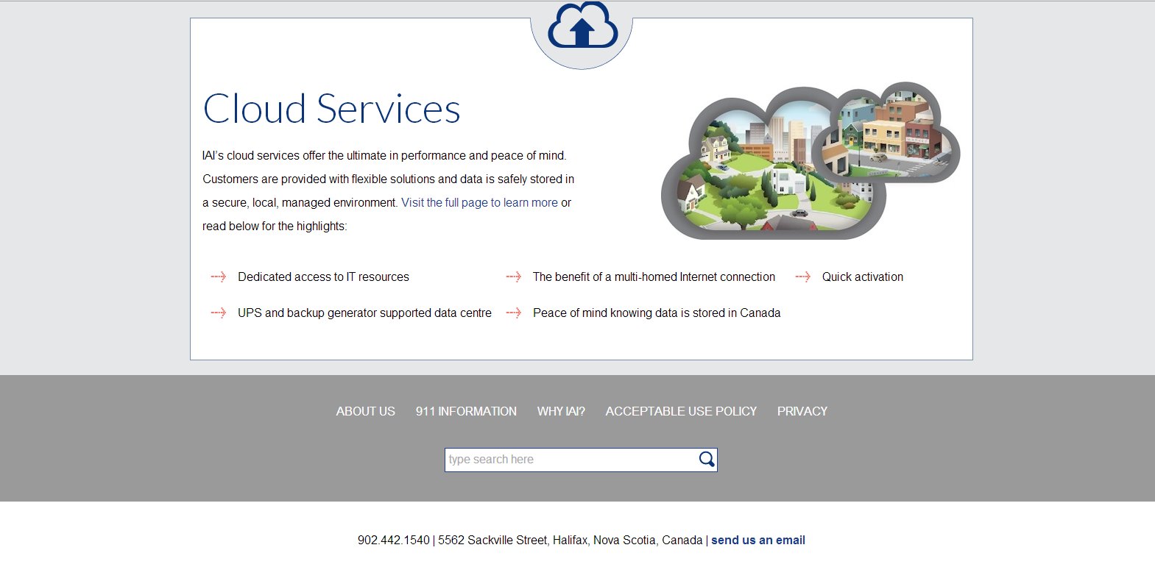
Thank-you
bruce.macdougall@internetworking-atlantic.com

