Slide 1
Sensei Agile PPM™
Delivering Agile Projects using Microsoft Project
by Sensei Project Solutions

Slide 2
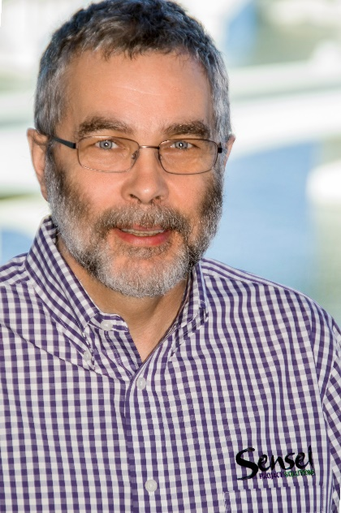
Your Moderator
Steve Caseley PMP, PMI-ACP, PMI-SP, Scrum Master
35 Years experience in IT Consulting/Project Management
Authored and edited Project Management Books
Proactive PPM with Microsoft Project for Project Server and Project Online
PMP and CAPM Exam Prep Questions and Answers
PMP In Depth – Study Guide for the PMP exam
Project Management Training (Agile and PMP)
University Instructor (Graduate and Under Graduate)
CBT Nuggets Instructor
Notes:
Here is a little bit about me. I spent a number of years working in high-tech product development, managing complex projects involving both hardware and software. I am both a certified project manager and Microsoft certified in Project and SharePoint. In my role at Sensei I focus primarily on PPM business process solutions, and am involved in all phases of a PPM deployment.

Slide 3
Sensei Agile PPM™
Agile Solution for Project Pro and PWA
Support Agile/Scrum principles such as Product Backlog, Story Grooming, Burn Down Charts and Iterative Delivery
Best Practices and Process Guidance
Agile principles built in with process validation to ensure compliance with iterative development approaches
Supports Bi-modal delivery
Fully integrated solution supports bi-modal delivery allows traditional and iterative projects to be delivered in a single tool environment

Slide 4
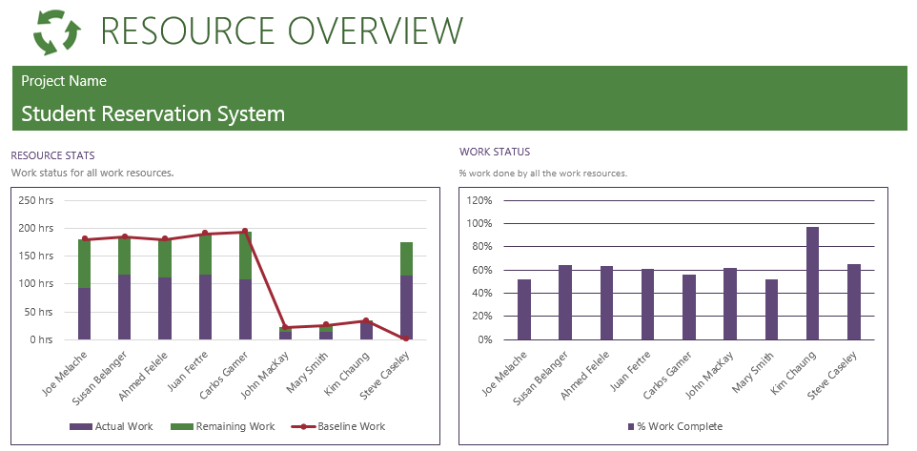
Full Suite of Agile Information Radiator Reports
Agile Report
Library

Slide 5
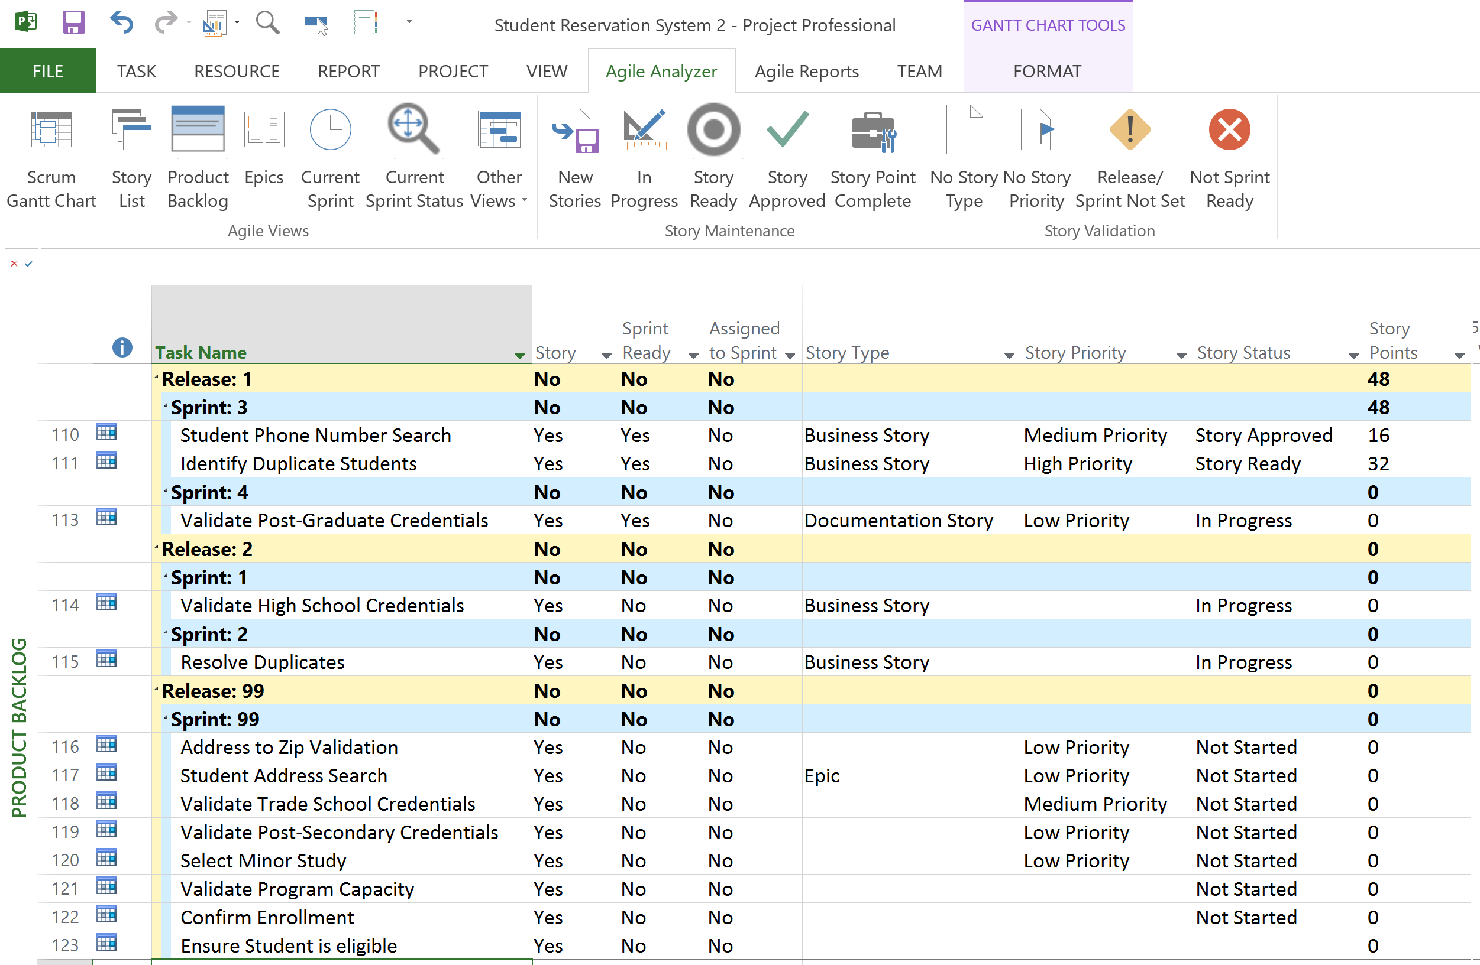
Agile Ribbons and Functions
Agile Specific Ribbons
Agile Fields and Views support Agile Management
Principles

Slide 6
Project Demo

Slide 7
Epic and Task Management
Epic management allow stories to be developed over multiple Sprints
Stories can be decomposed into Tasks and managed within each Sprint
Notes:
This slide continues the overview of the “wow” factor. This is a custom view that clearly demonstrates that we can use Project as an Agile Management tool. Next to the Burndown charts, the next thing people look for in Agile is how do I manage my Story Backlog. This view:
Shows that we can assign stories to Releases and Sprints to plan what stories will ne done in each sprint – specifically references that the “velocity” of each sprint is managed for each sprint
That we are able to manage all the “agile” attributes of a story such as story type, priority and status. The values in these fields are table driven and can be configured to suit each customer’s requirements.

Slide 8
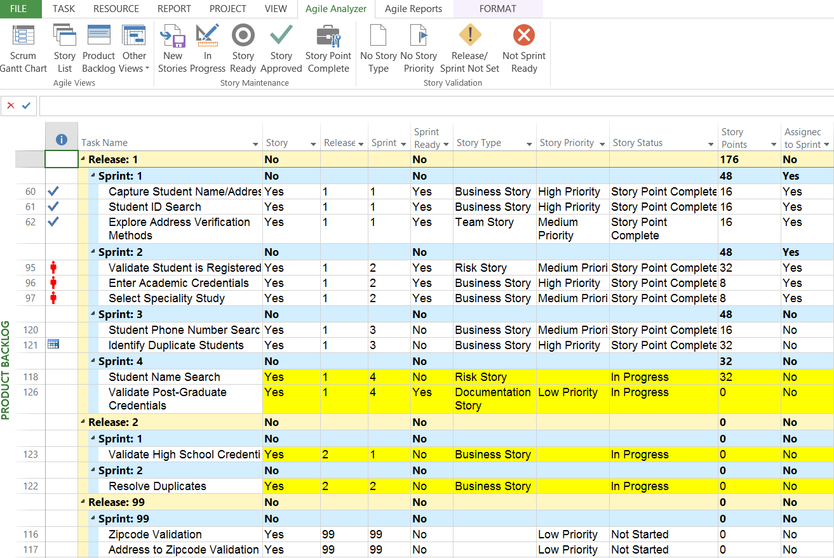
Increase Productivity with Process Validation
Process validation ensures compliance with Agile/Scrum Industry Standards
Integrated support
aids in Agile Management approaches

Slide 9
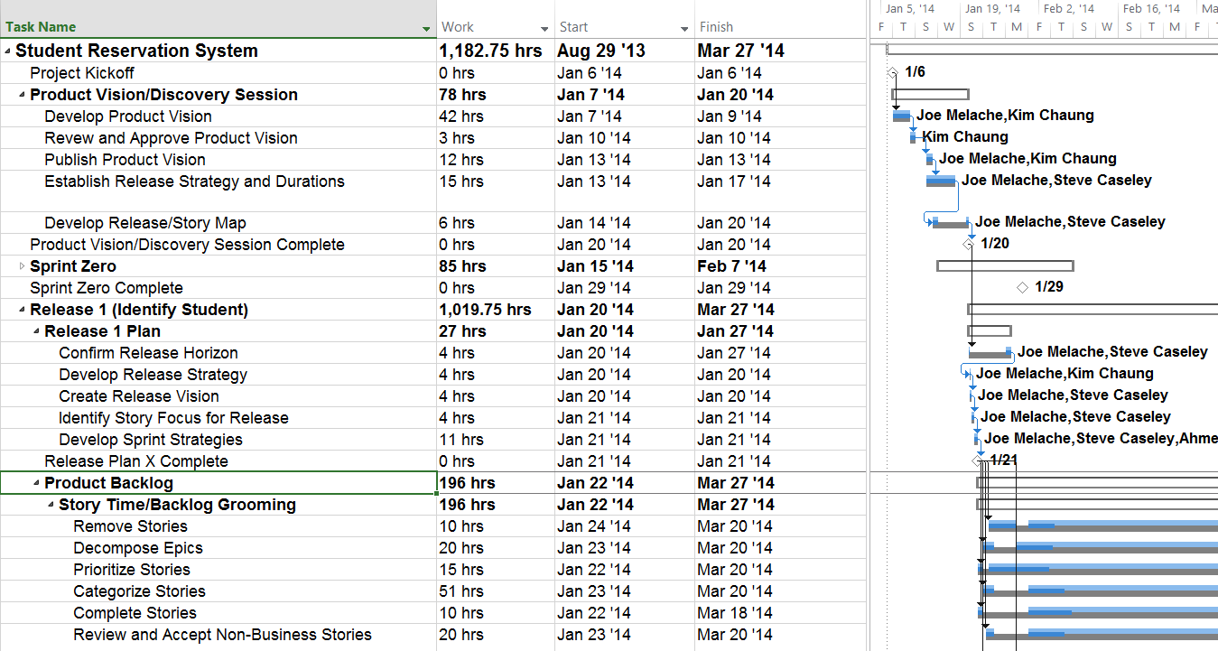
Agile Methodology Support
Detailed Agile WBS to support adaption and training

Slide 10
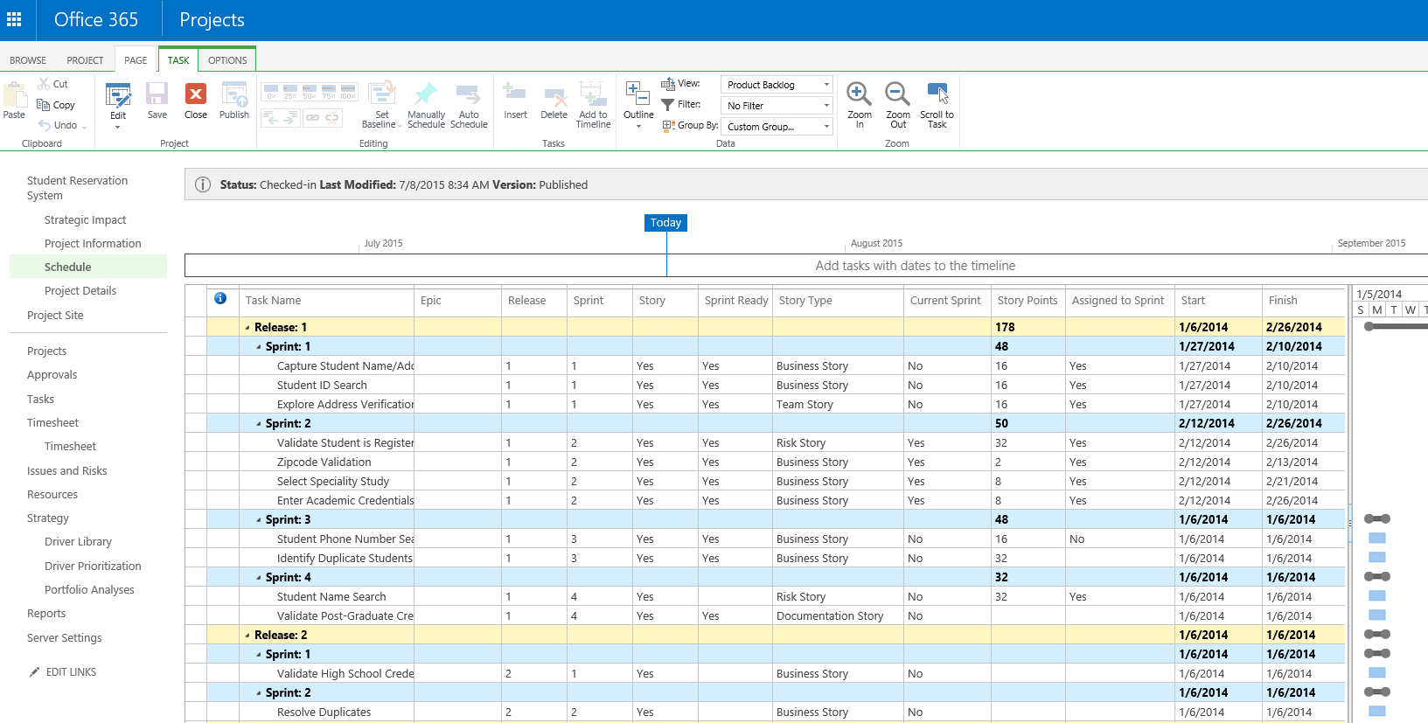
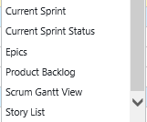
PWA Integration
Agile functionality available across complete toolset
Agile Views and Agile/Scrum Industry Standards in PWA
10

Slide 11
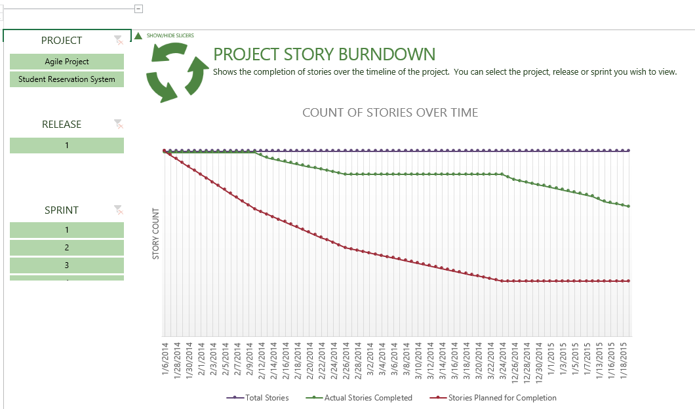
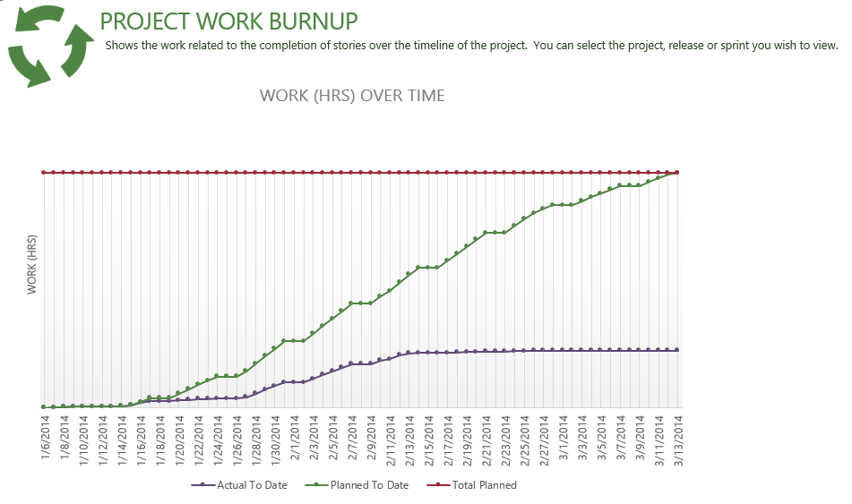
PWA Reports
Agile Reports available in PWA
Report content can be dynamically defined
Reports support
Story or Work Burndown or Burnup
11

Slide 12
PWA Demo

Slide 13
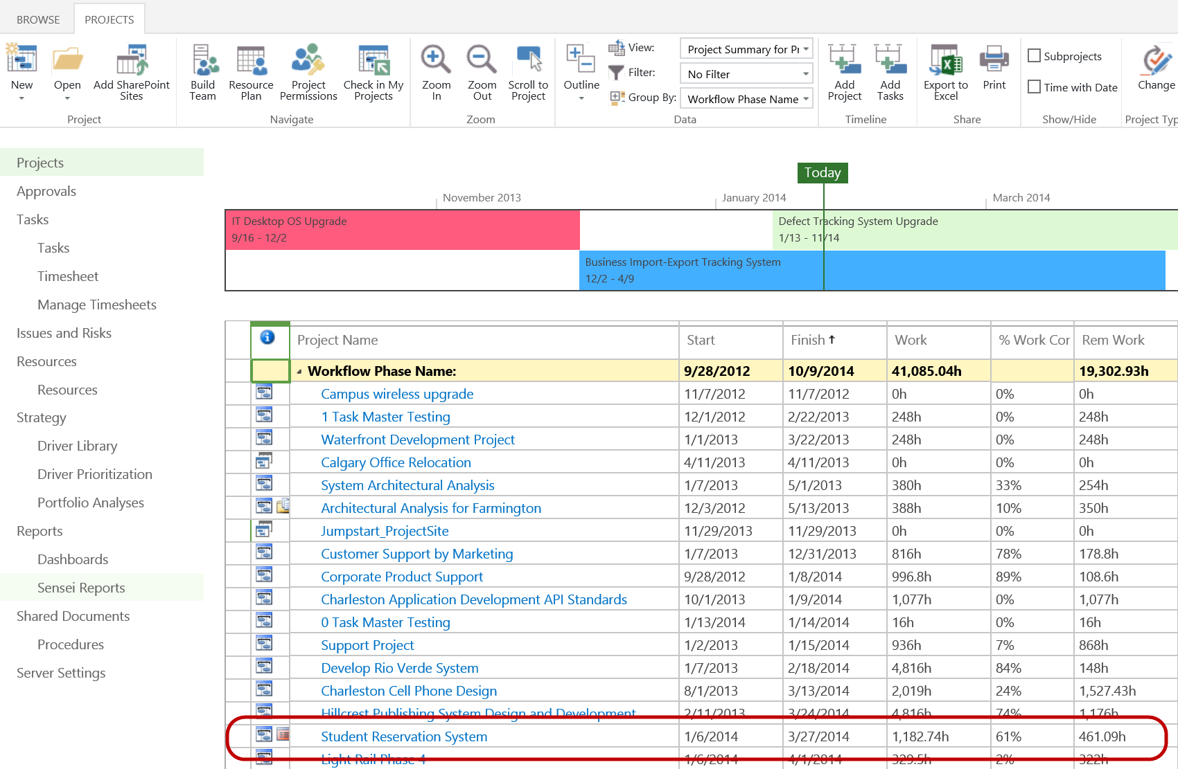
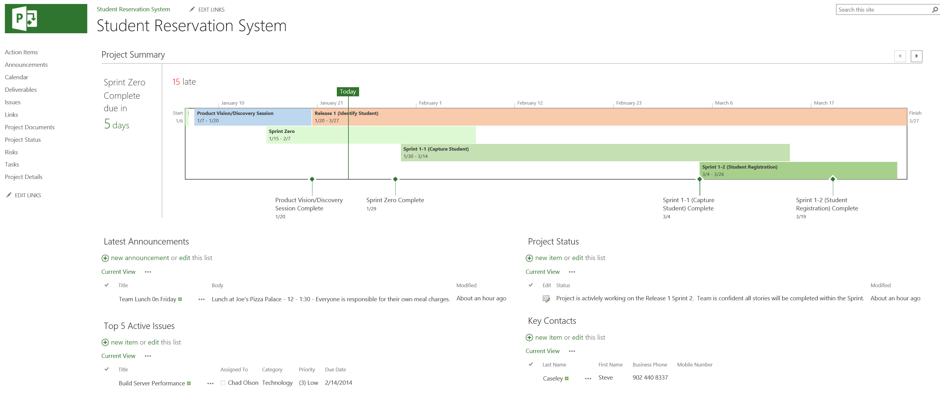
Bi-Modal Support
Agile and Traditional Projects Fully Integrated

Slide 14
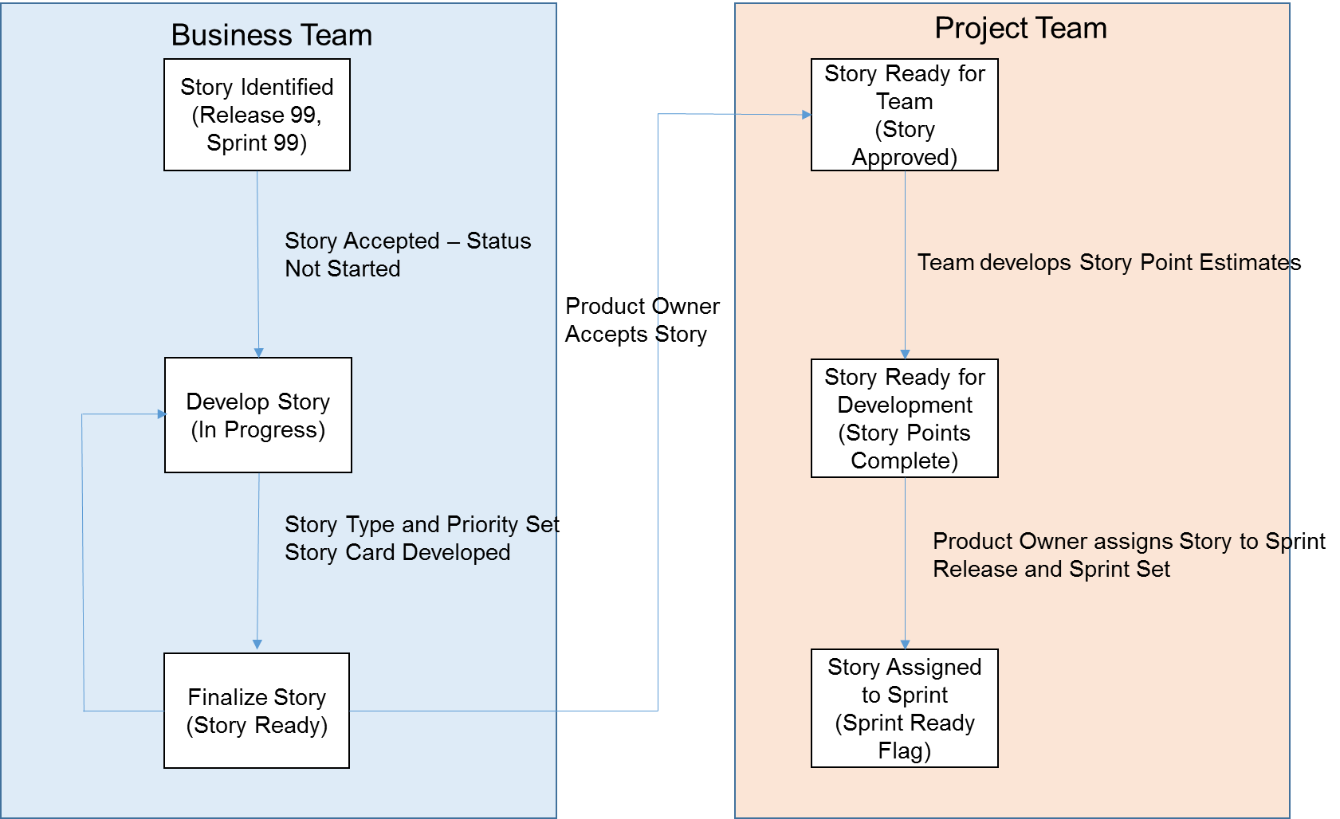
Agile / Scrum Industry Alignment
Detailed Agile Process
Fully Aligned with
International Standards
+

Slide 15
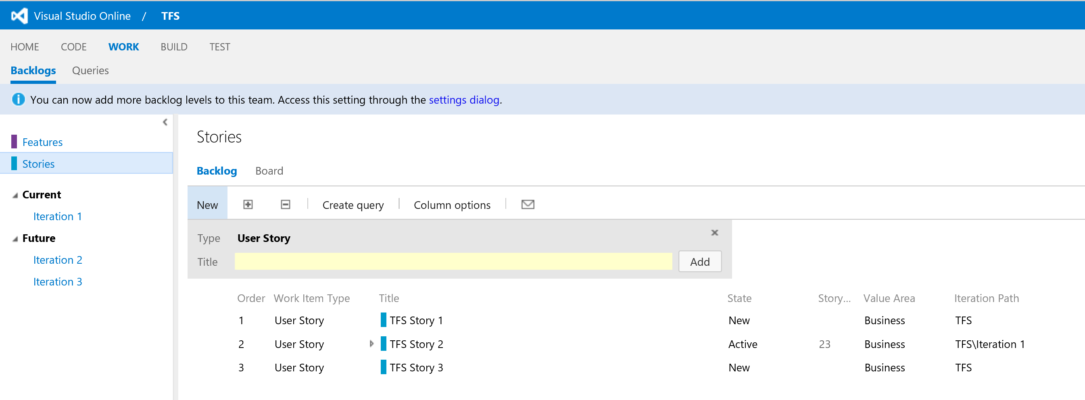
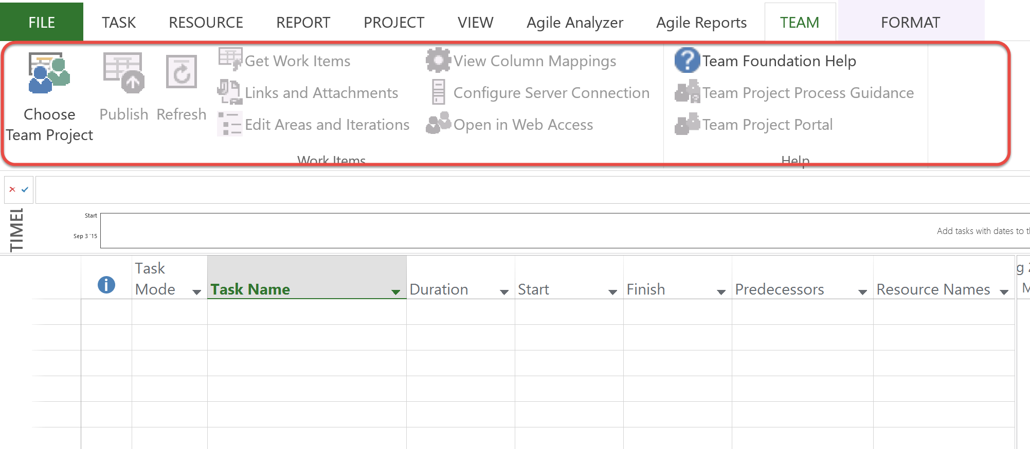
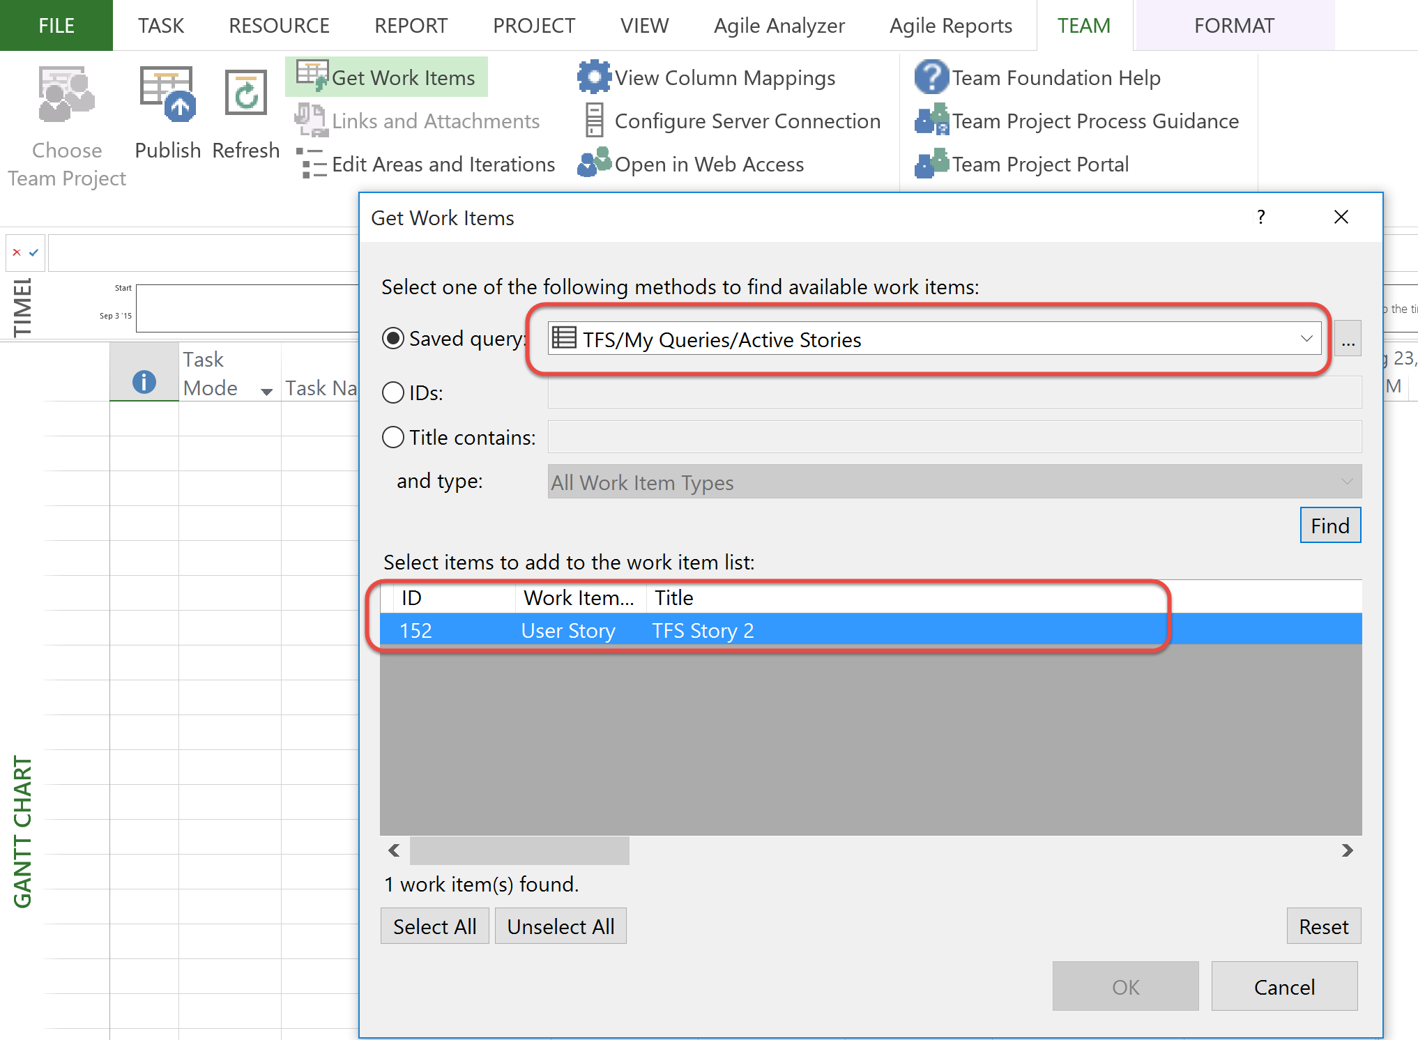
Integration with other tools
PM controls data integration by queries –Active Stories only – e.g.
TFS is system of record and all stories and tasks are maintained in TFS
Project Integration managed using the TFS addin Team Ribbon
Notes:
This slide and the next 3 slides are designed to get the viewer excited about the Sensei Agile Template and present the key components of the Agile Template.
This slide is focused on the Agile Burndown Charts, one of the most well known of the Agile reports or principles.
The Agile template has Burndown charts for both the current sprint and the total project. This report/slide typically has significant “wow” factor as a lot of people aren’t aware that we can produce very visual report in Project.

Slide 16
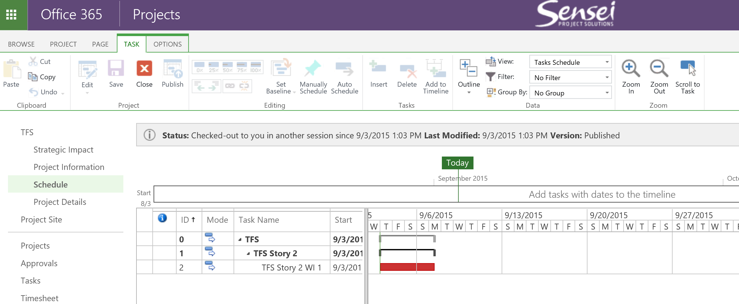
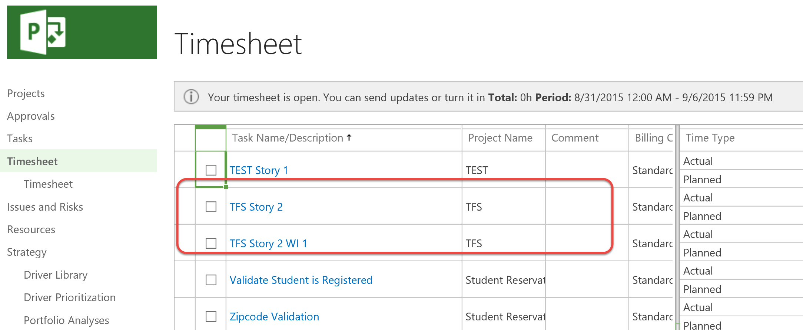
Integration with other tools
Project Schedule populated with TFS data
Schedule published to Project Online
Timesheet is populated with TFS Tasks
Notes:
This slide continues the overview of the “wow” factor. This is a custom view that clearly demonstrates that we can use Project as an Agile Management tool. Next to the Burndown charts, the next thing people look for in Agile is how do I manage my Story Backlog. This view:
Shows that we can assign stories to Releases and Sprints to plan what stories will ne done in each sprint – specifically references that the “velocity” of each sprint is managed for each sprint
That we are able to manage all the “agile” attributes of a story such as story type, priority and status. The values in these fields are table driven and can be configured to suit each customer’s requirements.

Slide 17
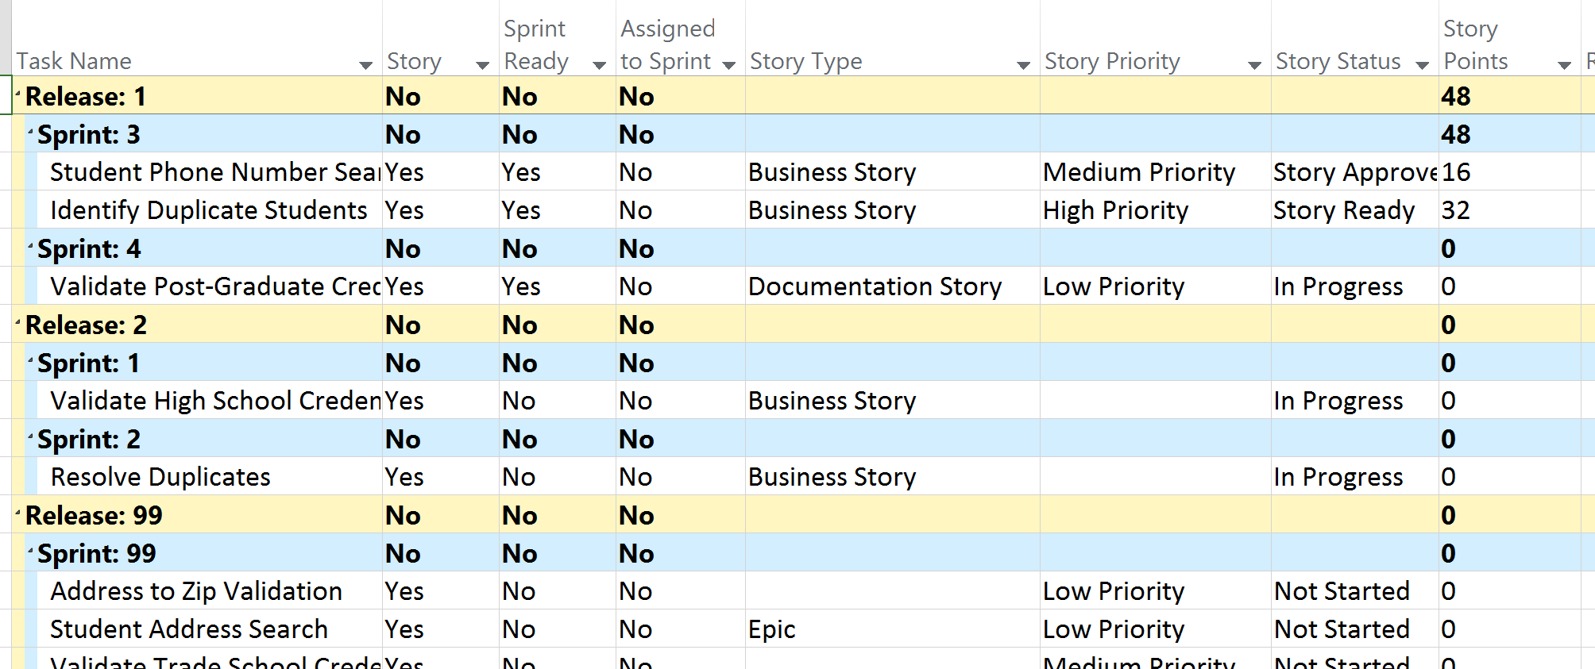
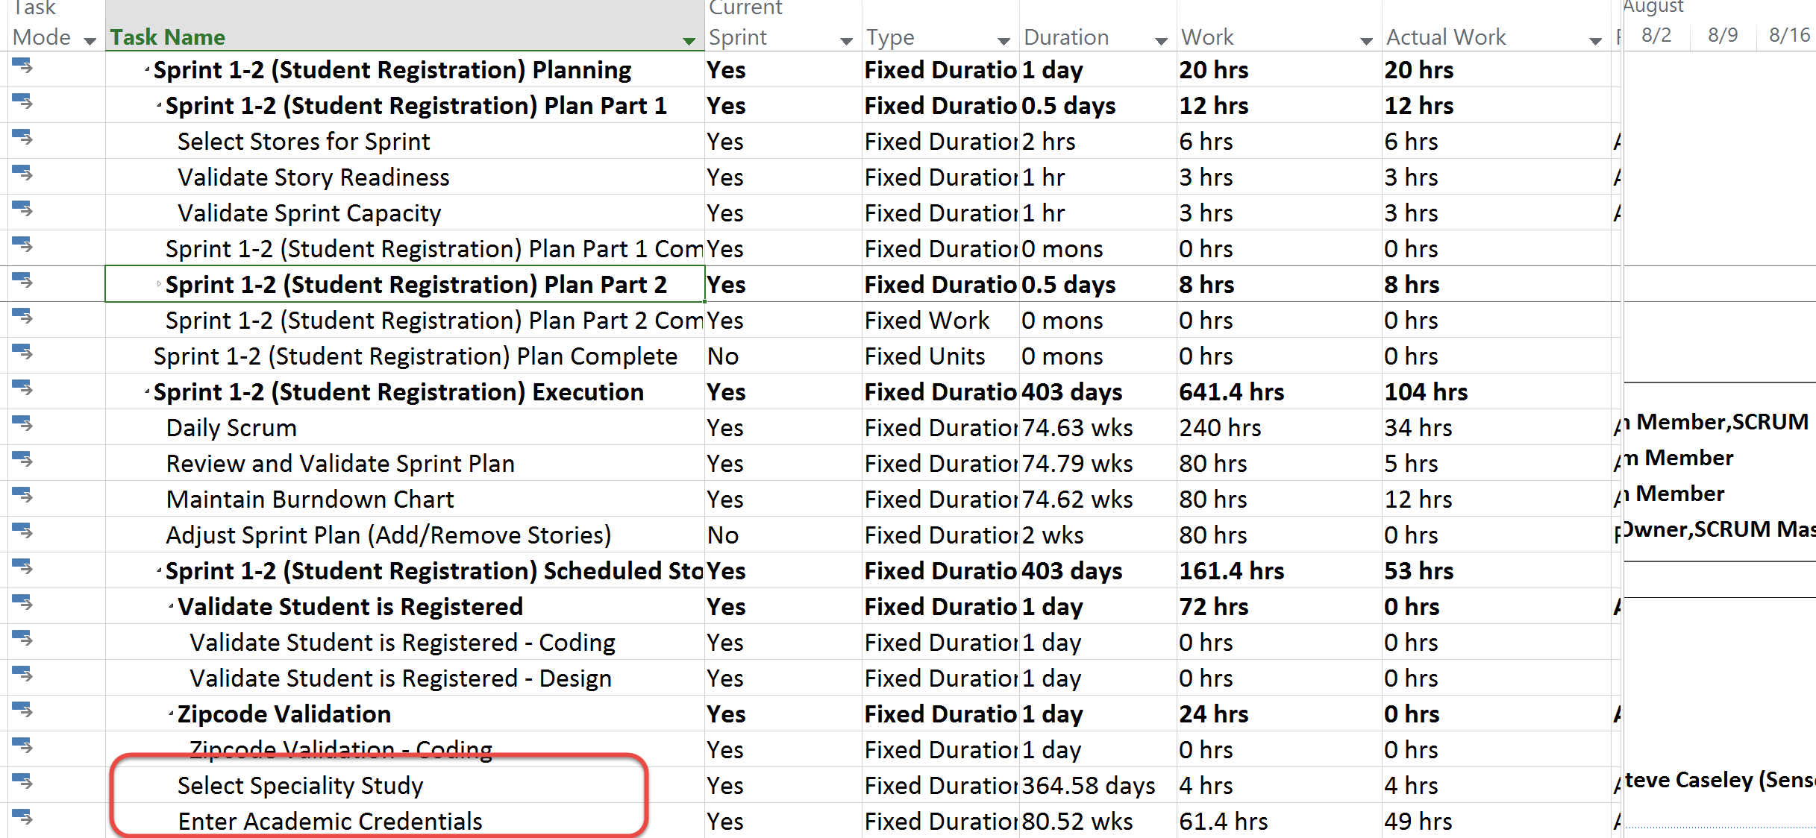
Either system can be System of Record
And published to TFS
Current Stories are selected for integration to TFS
Agile Project is managed in Project
Notes:
This slide continues the overview of the “wow” factor. This is a custom view that clearly demonstrates that we can use Project as an Agile Management tool. Next to the Burndown charts, the next thing people look for in Agile is how do I manage my Story Backlog. This view:
Shows that we can assign stories to Releases and Sprints to plan what stories will ne done in each sprint – specifically references that the “velocity” of each sprint is managed for each sprint
That we are able to manage all the “agile” attributes of a story such as story type, priority and status. The values in these fields are table driven and can be configured to suit each customer’s requirements.

Slide 18
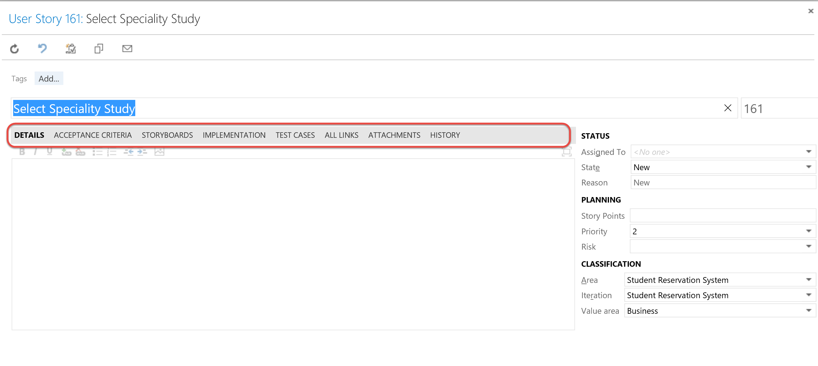
System of Record - Example (continued)
Stories are migrated to TFS
And can be associated with code and test cases
Notes:
This slide continues the overview of the “wow” factor. This is a custom view that clearly demonstrates that we can use Project as an Agile Management tool. Next to the Burndown charts, the next thing people look for in Agile is how do I manage my Story Backlog. This view:
Shows that we can assign stories to Releases and Sprints to plan what stories will ne done in each sprint – specifically references that the “velocity” of each sprint is managed for each sprint
That we are able to manage all the “agile” attributes of a story such as story type, priority and status. The values in these fields are table driven and can be configured to suit each customer’s requirements.

Slide 19
Integration Demo

Slide 20
For more information
See me in the Microsoft Booth
Web: www.senseiprojectsolutions.com
Mail: info@senseiprojectsolutions.com
Social Media:
SenseiPPM
Sensei Project Solutions
@SenseiPPM
SenseiProjectSolutions

